Slide 1
Introduction to Programming in Python
Ezekiel Adebayo Ogundepo (@gbganalyst)

Slide 2
String Manipulation in Python

Slide 3
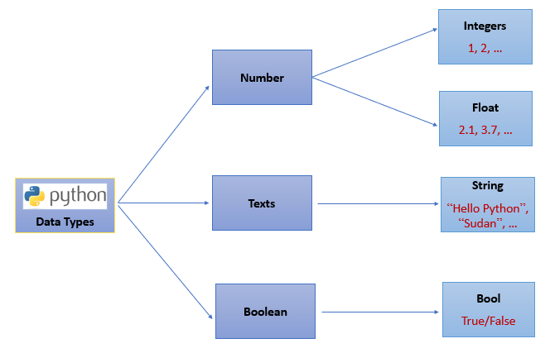
Data types
Python can tell you the data type by using type() function. Python refers integer number as int, float as float, character or text as str and boolean as bool.

Slide 4
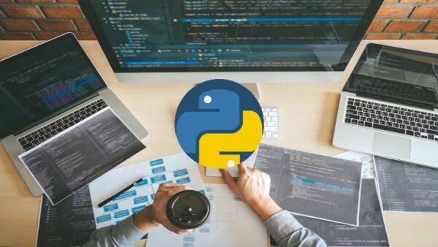
Lab session

